Slide 1
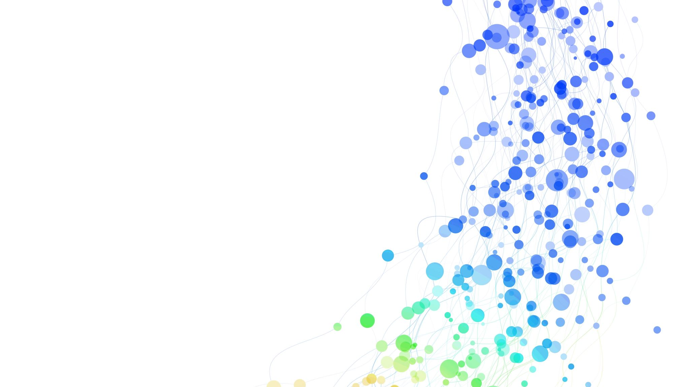
IST 652 - Final Project Presentation
- Harshit Joshi
Yashaswini Kulkarni

Slide 2
Purpose
Global warming has had alarming effects on the environment including modification of rainfall patterns, amplification of coastal erosion, lengthening of growing season, melting of ice caps and glaciers and so on. In this particular project, we are trying to determine,
At what point in the world history, did global warming start increasing?
Is CO2 emission one of the major contributing factor for the increase?
In addition to these questions, we are answering the following questions as well:
Which country has the highest per capita CO2 emissions?
Which countries are among the highest contributing countries towards the global warming?

Slide 3
Data
GlobalTemperature.csv – Gives the global land temperature including the average, minimum and maximum starting from the year 1750.
GlobalLandTemperatureByCity.csv - This gives the global land temperatures grouped by all cities.
Historical_emissions.csv - Historical emissions of carbon dioxide for close to 3 decades for all countries across the globe.
World_population.csv – This csv contains world population in terms of countries. This is used to determine per capita CO2 emissions for every country.

Slide 4
Conclusions
During our analysis, we discover that the world temperature is increasing at alarming rates in the past 30 years.
We identify that in 1975, there was a sharp increase in the global temperature. This suggests that this was the point of sharp jump in the impacts of global warming.
Since the time frame of industrialization which was between the late 19th century and the beginning of the 20th century coincides with our previous conclusion, it is concluded that, industrialization might have had a negative impact on the global temperature and hence intensified global warming.

Slide 5
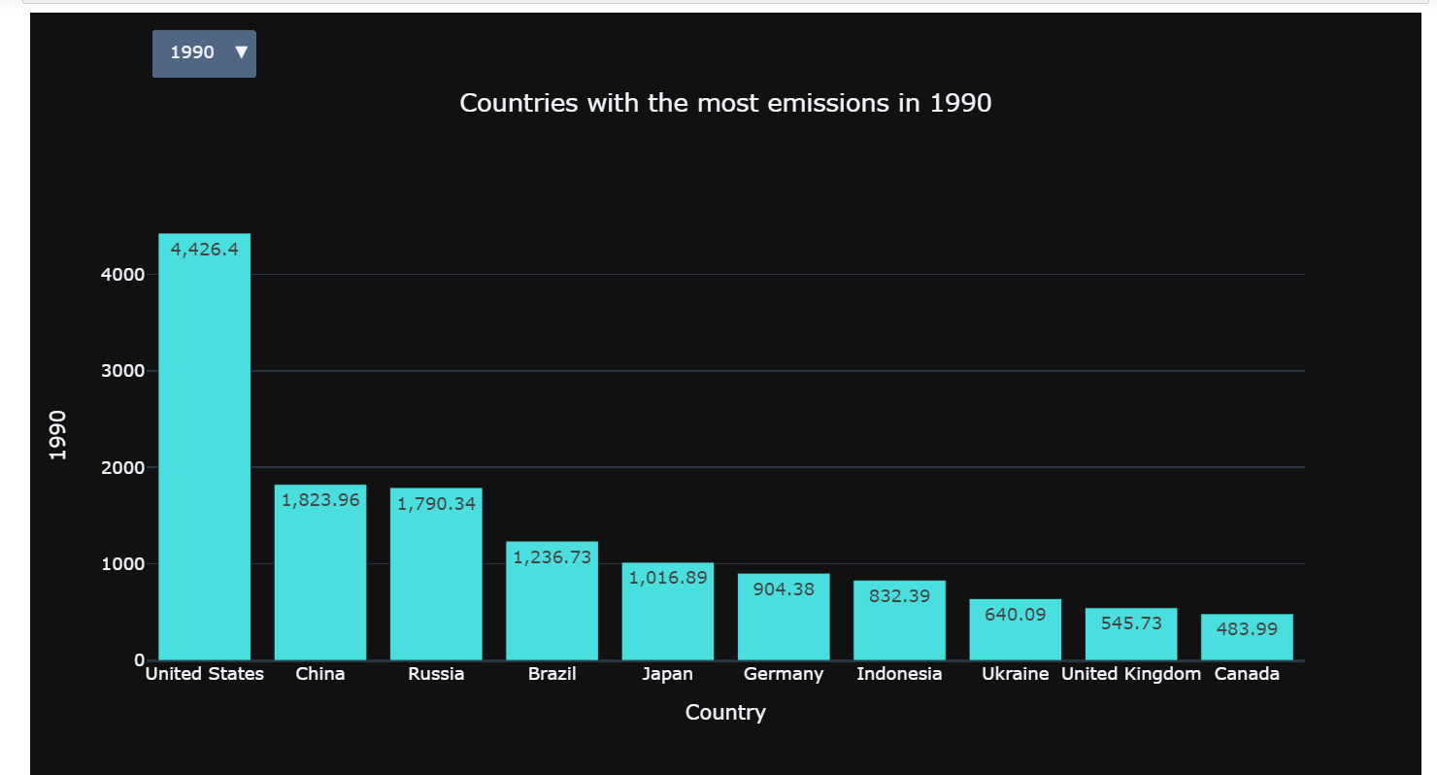
Conclusions
Through our analysis, we conclude that ‘Qatar’ has the highest per capita CO2 emissions.
Additionally, these are the countries which are among the largest contributors of CO2 emissions:

